Slide 1
Chapter 2 HARDWARE Part 1 – Evolution Part 2 – System Unit Part 3 – Input Output Part 4 - Secondary Storage Part 5 –Hardware Trends

Slide 2
Learning Objectives Part 1 – Evolution of IT Hardware
Explain the stage of IT Infrastructure
Different type of computer hardware

Slide 3
Evolution of IT Infrastructure
Stages in IT Infrastructure Evolution
Mainframe / Mini Computers (1959- present)
Personal Computer (1981 – present)
Client / Server Computing (1983 – Present)
Web-based Enterprise Computing (1992 – present)
Cloud / Mobile Computing (2000 – present)
Edge Computing / IoT (2010 – present)

Slide 4
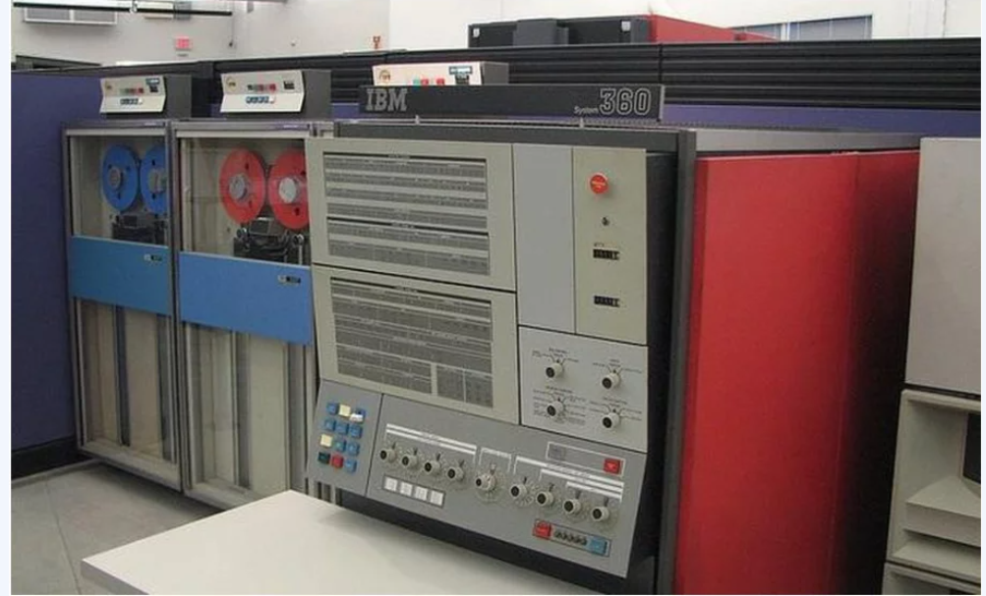
General-Purpose Mainframe and Minicomputer Era: (1959 to Present)
The introduction of the IBM 1401 and 7090 transistorized machines in 1959 marked the beginning of widespread commercial use of mainframe computers. In 1965, the mainframe computer truly came into its own with the introduction of the IBM 360 series. Mainframe computers became powerful enough to support thousands of online remote terminals connected to the centralized mainframe using proprietary communication protocols and proprietary data lines.
Minicomputer – powerful yet less expensive computers, allowing decentralized computing customizable to individual departments or business units

Slide 5
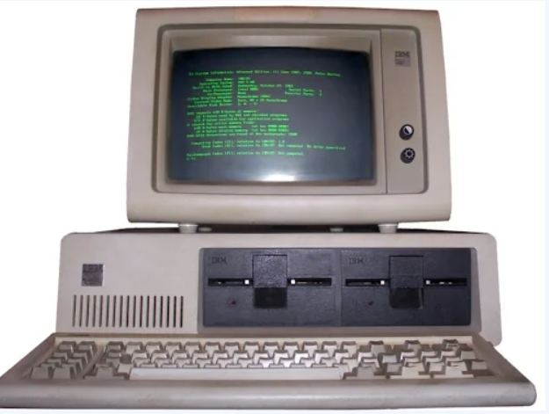
Personal Computer Era: (1981 to Present)
Proliferation of PCs in the 1980s and early 1990s launched a spate of personal desktop productivity software tools—word processors, spreadsheets, electronic presentation software, and small data management programs—that were very valuable to both home and corporate users. These PCs were stand-alone systems until PC operating system software in the 1990s made it possible to link them into networks.

Slide 6
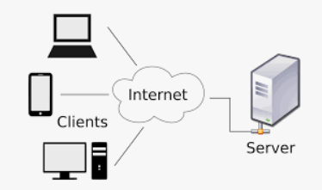
Client/Server Era (1983 to Present)
In client/server computing, desktop or laptop computers called clients are networked to powerful server computers that provide the client computers with a variety of services and capabilities. Computer processing work is split between these two types of machines. The client is the user point of entry, whereas the server typically processes and stores shared data, serves up Web pages, or manages network activities. The term “server” refers to both the software application and the physical computer on which the network software runs. The server could be a mainframe, but today, server computers typically are more powerful versions of personal computers, based on inexpensive chips and often using multiple processors in a single computer box., or in server racks.

Slide 7
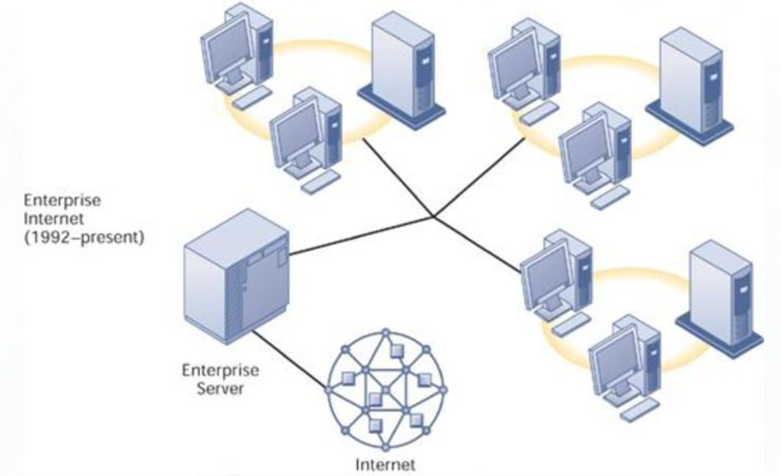
Web-based Enterprise Computing Era (1992 to Present)
In the early 1990s, firms turned to networking standards and software tools that could integrate disparate networks and applications throughout the firm into an enterprise-wide infrastructure. As the Internet developed into a trusted communications environment after 1995, business firms began seriously using the Transmission Control Protocol/Internet Protocol (TCP/IP) networking standard to tie their disparate networks together.

Slide 8
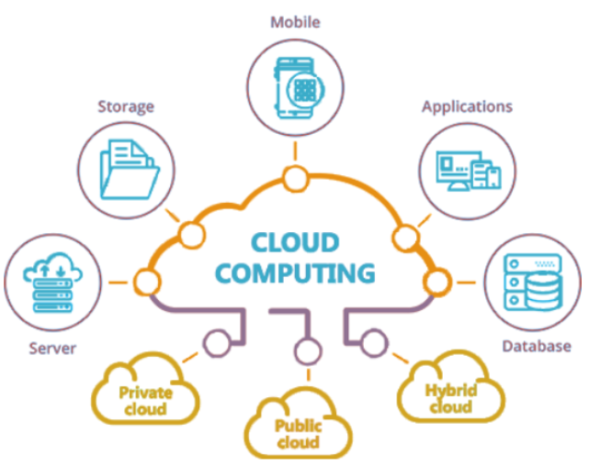
Cloud and Mobile Computing Era (2000 to Present)
The growing bandwidth power of the Internet has pushed the client/server model one step further, towards what is called the “Cloud Computing Model.” Cloud computing refers to a model of computing that provides access to a shared pool of computing resources (computers, storage, applications, and services) over a network, often the Internet. These “clouds” of computing resources can be accessed on an as-needed basis from any connected device and location.

Slide 9
Edge Computing and IoT Era (2010-present)
As IoT devices proliferated, there was a need to process data closer to where it was generated to reduce latency and bandwidth usage, leading to the growth of edge computing.
improve real-time data processing and real-time decision-making

Slide 10
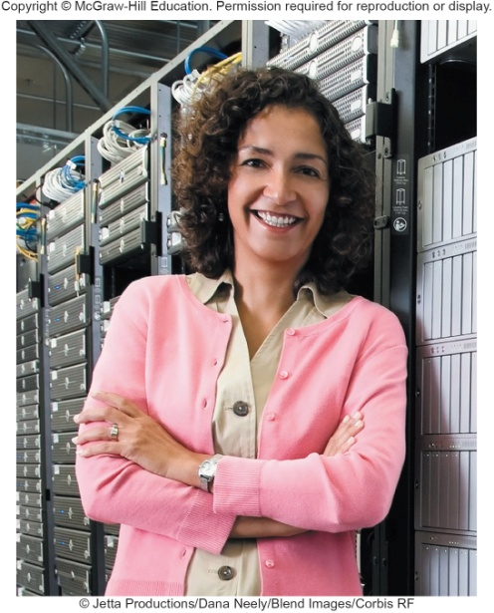
HARDWARE -Part 2 (System Unit) Introduction
Speed, capacity, and flexibility determine the power of personal computers.
Knowledge of a computer’s power allows you to make good buying decisions and to determine if your current system will run new applications.
Competent end users need to understand the functionality of the basic components of the system unit
Notes:
Inform students about the Computer Buyer’s Guide at the end of the book which provides additional information on purchasing a computer.

Slide 11
Learning Objectives Part 2 – System Unit
Differentiate between the five basic types of system units.
Describe system boards, including sockets, slots, and bus lines.
Recognize different microprocessors, including microprocessor chips and specialty processors.
Compare different types of computer memory including RAM, ROM, and flash memory.
Explain expansion slots and cards.
Describe bus lines, bus widths, and expansion buses.
Describe ports, including standard and specialized ports.
Identify power supplies for desktop, laptop, tablet, and mobile devices.
Explain how a computer can represent numbers and encode characters electronically.

Slide 12
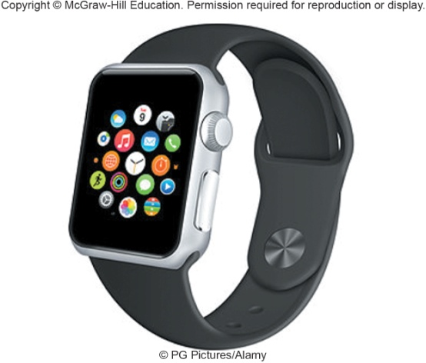
System Unit
System Unit Types
System Chassis
Container that houses most of the electronic components that make up a computer system
System Unit
Contains system’s electronic components and selected secondary storage devices
Desktops
System unit is in a separate case
Tower Units
All-in-Ones
All components including monitor
Laptops
Portable and much smaller
Ultrabooks – laptop and tablet in one
Gaming – high end graphics
Tablets
Mini tablet
Smartphone
Most popular device – handheld computer
Extend the capabilities of cell phones
Wearables
Contain embedded computers
Notes:
System unit (key term) is also referred to as the system chassis(Key Term)

Slide 13
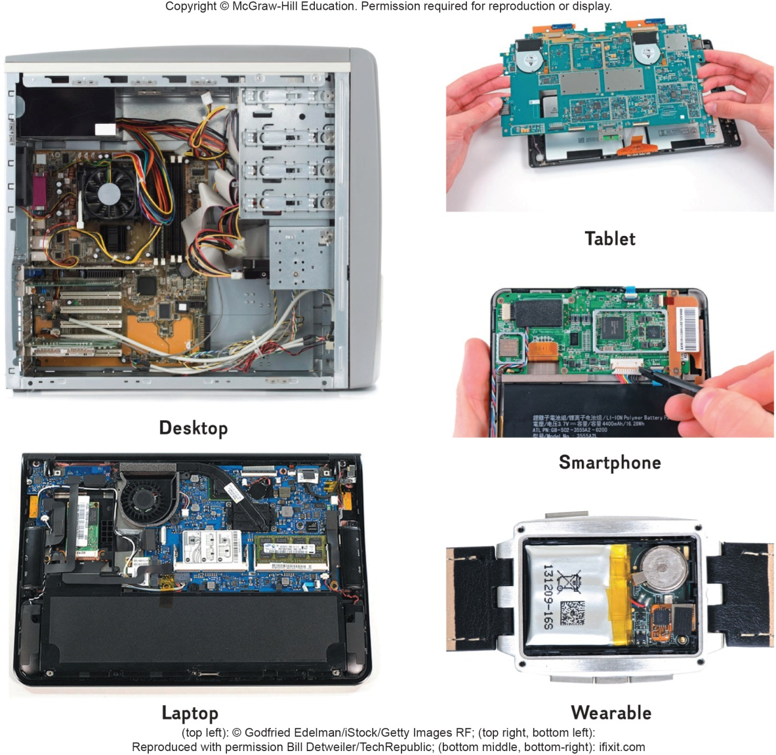
Components
Although all devices come in many shapes and sizes they have similarities such as
System boards
Microprocessors
Memory
Notes:
Components are very similar on different devices.

Slide 14
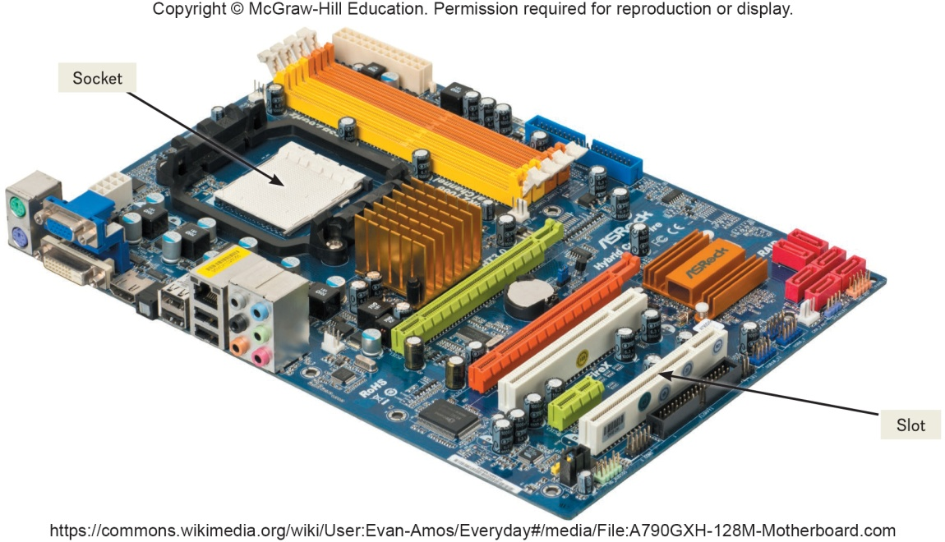
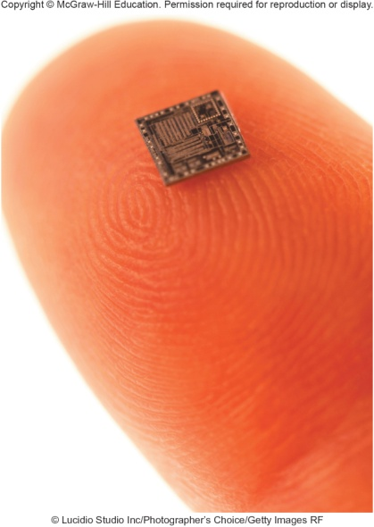
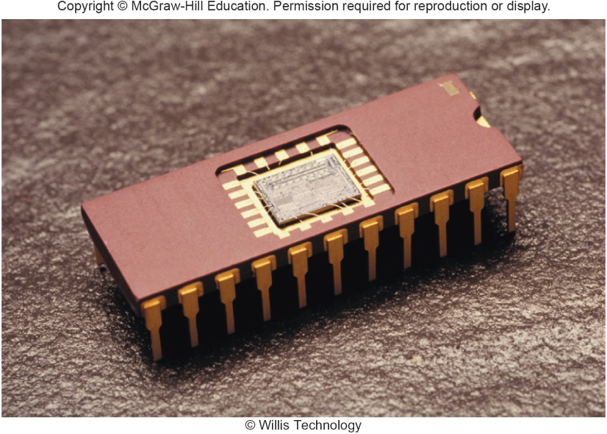
System Board
System board or main board or motherboard controls communication for the entire computer system
All components and devices connect to the system board
Data path and traffic monitor
Allows various components to communication efficiently with one another
The system board contains a variety of electronic components
Sockets – the connection point for chips
Chips
Tiny circuit boards etched onto squares of silicon
Also called silicon chip, semiconductor, or integrated circuit
Mounted on chip carriers
Notes:
System board (key term) or mainboard (key term) or motherboard (key term) – controls communication for the entire computer system
All devices and components connect to the system board
Acts as a data path and traffic monitor that allows the components to communicate with each other.

Slide 15
Slots and Bus Lines
Microprocessor
Additional system board components:
Slots
Provide a connection point for specialized cards or circuit boards
Provide expansion capabilities for the computer
Bus lines
Connecting lines that provide pathways to support communication among electronic components
Central Processing Unit (CPU) or Processor
Contained on a single chip call a Microprocessor
Brains of the computer
Two Basic Components of the CPU
Control unit
Tells the computer system how to carry out a program’s instruction
Arithmetic-logic unit (ALU)
Performs arithmetic and logical operations
Notes:
Slots (key term) – connection point for specialized cards or circuit board
Provides expansion capability
Bus lines (key term) –connecting lines that provide pathways that support communication

Slide 16
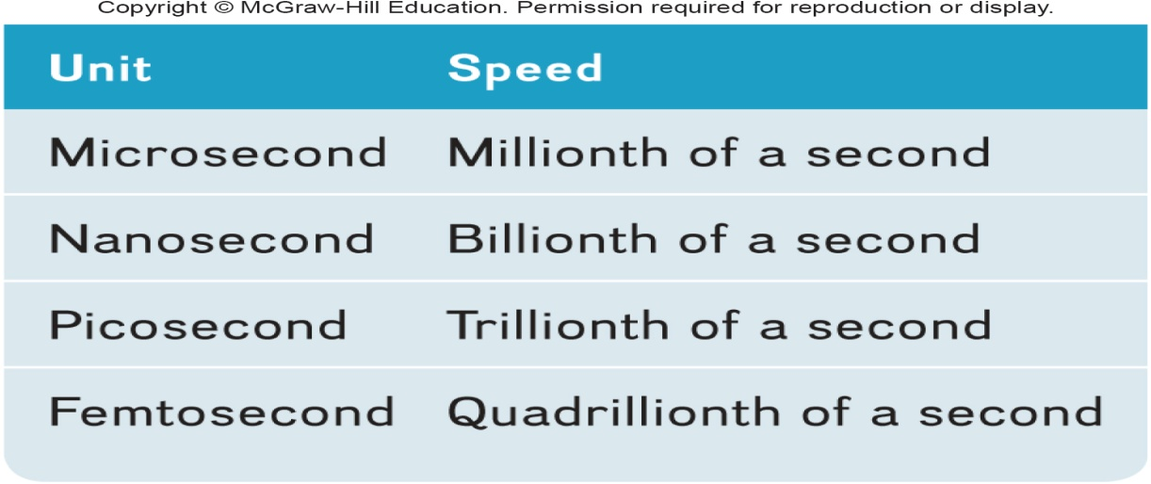
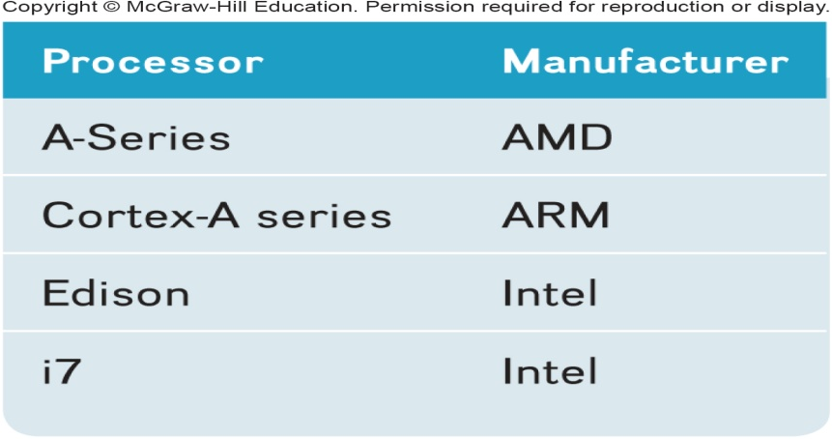
Microprocessor Chips
Multicore Chips
Chip capacities are expressed in word size
Word is the number of bits that can be processed at one time: 16, 32 or 64
Clock Speed
Processing speed or the number of times the CPU fetches and processes data or instructions in a second
Multicore Processors
Two or more separate and independent CPUs within a system unit
Quad-core supports 4 core processes
Parallel Processing
Computer’s ability to divided tasks into parts that can be distributed across each core
Windows 8 and Mac OS X support parallel processing
Notes:
A word (Key Term) is the number of bits that can be accessed at one time by the CPU
8 bits group together to form a byte
32 bit word computer can access 4 bytes at a time
64 bit word computer can access 8 bytes at a time
Clock speed (key term) – number of times the CPU can fetch and process data and instructions in a second
Older computers measured in millionth of a second – microsecond
Newer computers measured in billionth of a second – nanosecond
Super computers measured in picoseconds

Slide 17
Specialty Processors
Coprocessors
Designed to improve specific computing operations
Graphics Processing Unit (GPU) / Graphics coprocessors
Designed to handle a variety of specialized tasks
3D images
Encrypting data
Standard features in gaming computers
Notes:
Specialty processors are designed to handle special functions
Coprocessor (key term) chips designed to improve specific computing operations
Graphics coprocessor (key term), Graphics Processing Unit
Displaying 3-D images and encrypting data
Cars may have up to 70 specialty processors now.

Slide 18
Memory
Holding area for data, instructions, and information
Contained on chips connected to the system board
Three well-known types of memory chips:
RAM
Random Access Memory
ROM
Read Only Memory
Flash Memory
Notes:
Memory (key term) – holding area for data, instructions and information
RAM (Random-access memory) (Key Term)
ROM (Read-only memory) (Key Term)
Flash (Key Term)

Slide 19
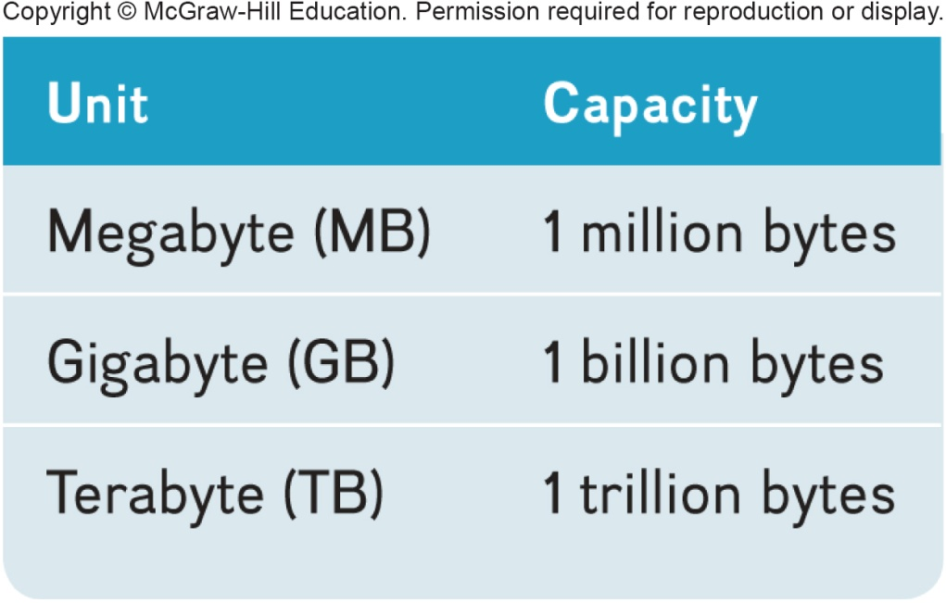
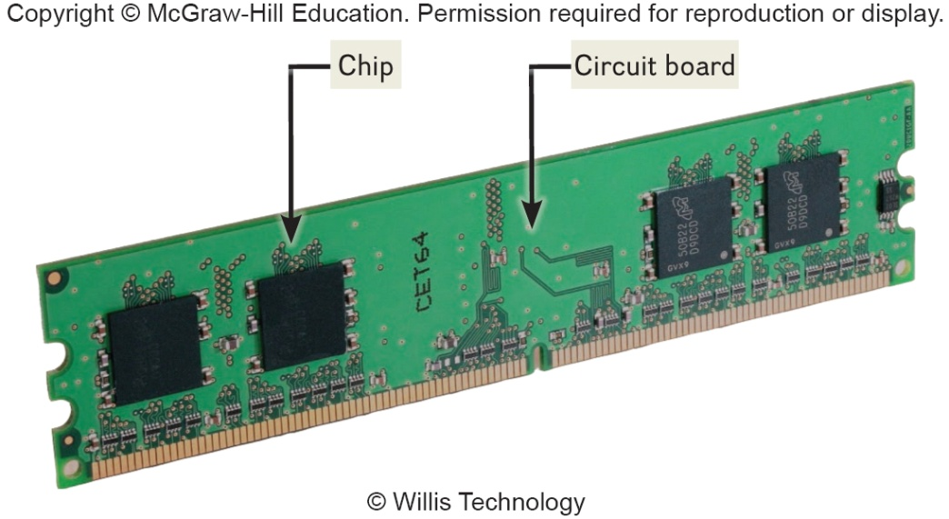
RAM
Random Access Memory (RAM) chips hold programs and data that the CPU is presently processing
Volatile or temporary – contents are lost when computer is powered off
Cache memory – temporary, high-speed holding area between the memory and CPU
Additional RAM can be added using an expansion module called a DIMM (Dual in-line memory module)
Virtual Memory
Dividing a program between memory and storage enabling the system to run very large programs
Memory is expressed in bytes
Notes:
Temporarily holds data and programs being processed by the CPU
Volatile - when power shuts off, contents of RAM are emptied
Exception - flash RAM can retain data when power disrupted, used in high end portable computers
Cache memory (key term) – improves processing by acting as a temporary high-speed holding area between the memory and CPU
Area in RAM set aside to store information frequently accessed
DIMM (dual in-line memory module) (key term) – additional RAM
RAM is also referred to as temporary or volatile storage
It is a good idea to save your work in progress to a second a secondary storage device. which is permanent or nonvolatile storage

Slide 20
ROM
Read-only memory (ROM)
Information stored by the manufacturer
Non-volatile and cannot be changed
CPU can read, or retrieve data and programs in ROM but the computer cannot change ROM
Contain special instructions
Start the computer
Access memory
Handle keyboard input
Notes:
ROM is used for special instructions such as starting the computer, accessing memory and handling keyboard input.
Many ROM chips have been replaced by flash memory by many applications

Slide 21
Flash Memory
Flash memory combines of the features of:
RAM, it can be updated
ROM, it is non-volatile
Contains startup information
BIOS (basic input/output system)
Amount of RAM
Type of keyboard, mouse, and secondary storage devices connected
Many ROM chips are being replaced by flash memory
Notes:
Used for a wide-range of applications
Used to store start-up instructions; BIOS (basic input/output system) (key term)
Flash memory – can retain data even if the power is disrupted
Most expensive type of RAM
Used for digital telephones, digital video cameras, and portable computers

Slide 22
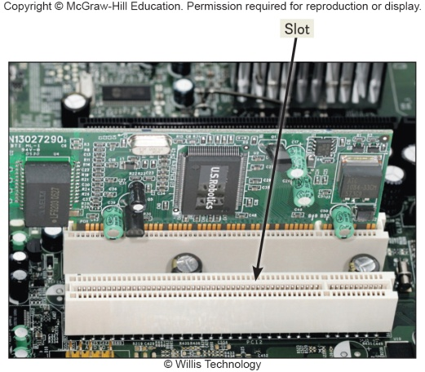
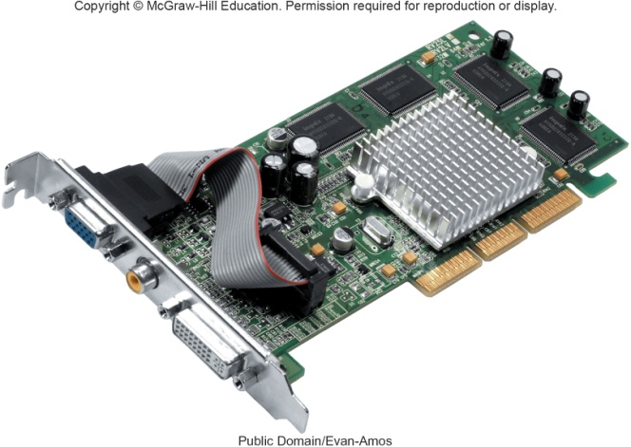
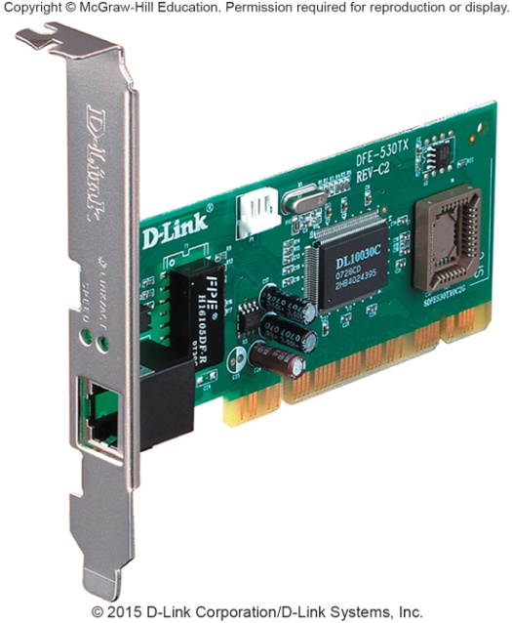
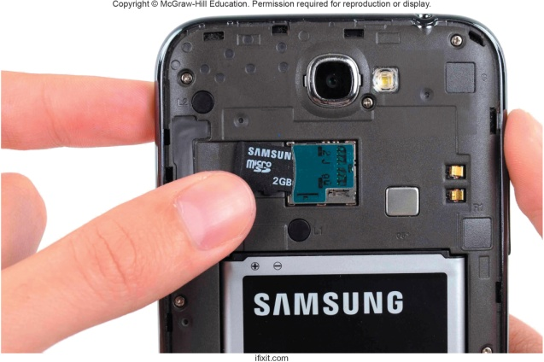
Expansion Slots and Cards
Expands your system’s capabilities
Graphics cards for high quality 3D graphics
Network interface cards (NIC) connect devices to networks via cables
Wireless network cards connect devices to networks without cables
SD cards
Expansion cards for mobile devices
Notes:
Expansion slots (key term) used to insert expansion cards (key term)
Graphics cards (Key term) - provides high quality of 3-D graphics
Network Interface Cards (Key Term) (NICs) or Network Adapter Cards) – attaches a user to a network
Wireless network cards (key term) – allow computers to be connected to a network without cables
SD Cards (key term) – expansion cards for laptops, tablets and smartphones.

Slide 23
Bus Lines / Bus
Expansion Buses
Connect parts of the CPU to each other and various other components on the system board
Pathway for bits representing data and instructions
Bus width
Number of bits that can travel simultaneously down a bus
Architecture and design are tied to the speed and power for the computer
Two basic categories of buses
System bus – connects CPU to memory
Expansion bus – connects CPU to other components
Principle types:
Universal Serial Bus (USB)
Connects external USB devices onto the USB bus
FireWire
Primarily used to connect audio and video equipment to the system board
PCI Express (PCIe)
Single dedicated path for each connected device
Notes:
Bus lines provide (key term) data pathways that connect various system components
A bus line is also called a bus (Key Term)
Bus width (key term) is the number of bits that can travel at once
It is a pathway for bits representing data and instructions
A bus is similar to a multilane highway.
Every computer has two basic categories of buses
System bus (key term) – connects the CPU to memory on the system board
Expansion bus (key term) – connects the CPU other components and to slots on the system board

Slide 24
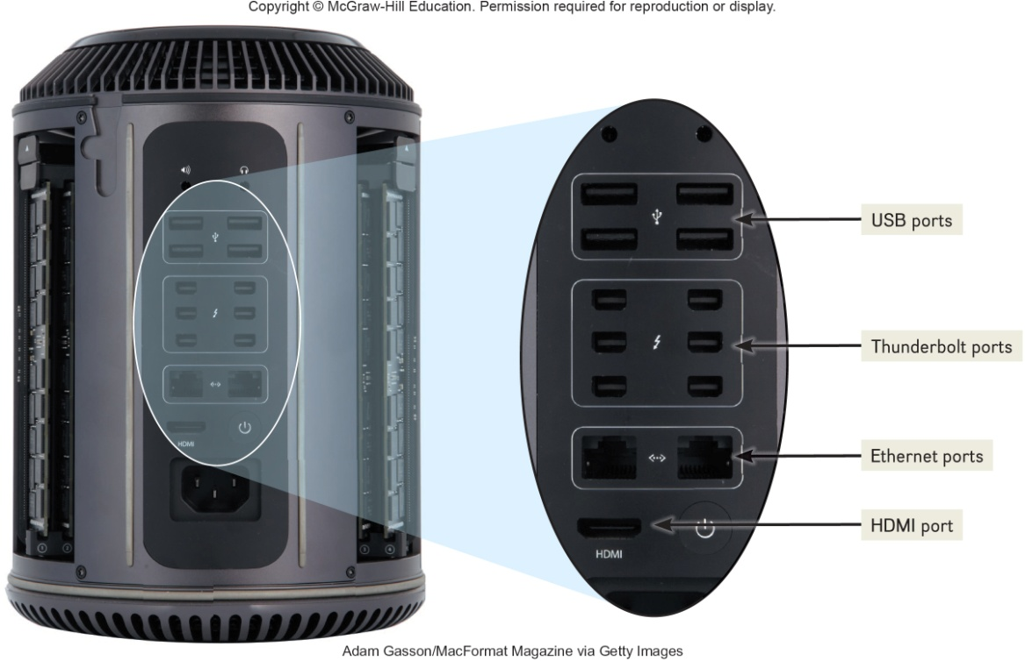
Ports
Socket for connecting external devices to the system unit
Ports connect directly
To the system board
To cards inserted into slots on the system board
Two Types
Standard Ports
Specialized Ports
Notes:
Ports are connecting sockets on the outside of a system unit
Ports are often standard features of computer systems and others are more specialized
Two types of ports:
Standardized
Specialized

Slide 25
Standard Ports
Specialized Ports
USB
Keyboards, mice, printers, storage devices
Ethernet
High speed networking
HDMI – High Definition Multimedia Interface
High definition video and audio
Thunderbolt
Provides high-speed connections
Can connect up to 7 separate devices through 1 port
External Serial Advanced Technology Attachment (eSATA)
High-speed connection for external secondary storage
Musical Instrument Digital Interface (MIDI)
Connect musical instruments
Mini DisplayPort (MiniDP or mDP)
Connection to large monitors
VGA & DVI
Connections to analog and digital monitors
FireWire
High-speed connections to FireWire devices
Notes:
Port (key term) – socket for external devices
USB (universal serial bus) (key term) - connects several devices to the system unit
Ethernet (key term) – standard for networking, allows you to connect multiple computers for sharing files, or to a DSL or cable modem for internet access
HDMI (key term) – High-Definition Multimedia Interface – provides high-definition video and audio
Thunderbolt – identified by Apple’s MacBook Pro and provides a high-speed connection
Promises to replace a number of ports such as Mini Display port.

Slide 26
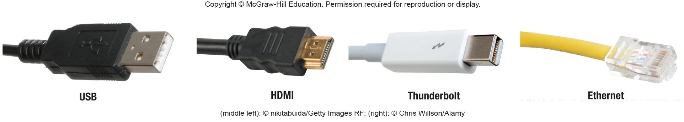
Cables
Used to connect external devices to the system unit via the ports
One end of the cable is attached to the device and the other end has a connector that is attached to a matching connector on the port
Notes:
Cables (key term) physical connections for devices to the system unit via ports

Slide 27
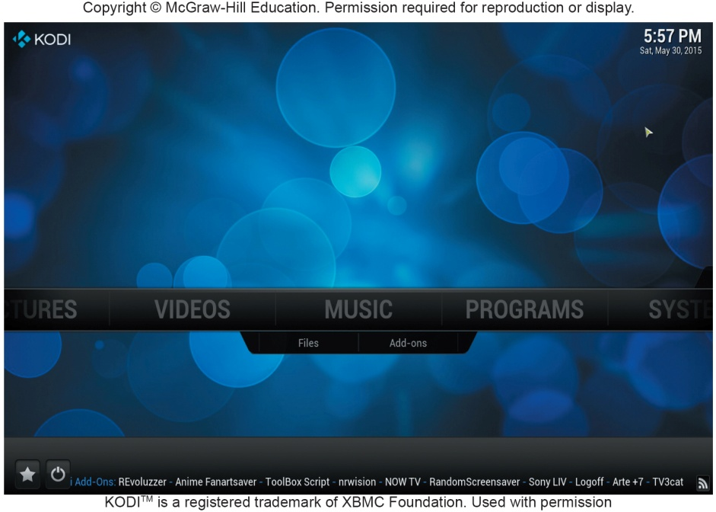
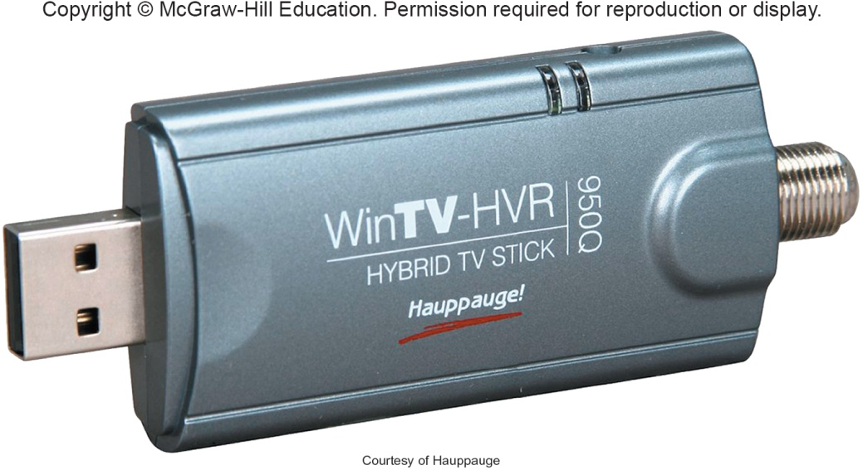
Making IT Work for You ~ TV Tuners
Using Windows Media Center as a DVR
Install TV Tuner to connect your computer or cable to your computer

Slide 28
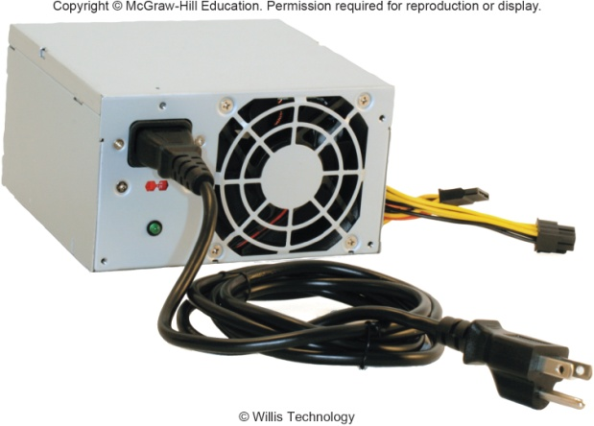
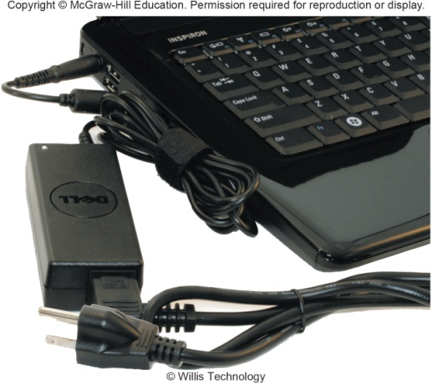
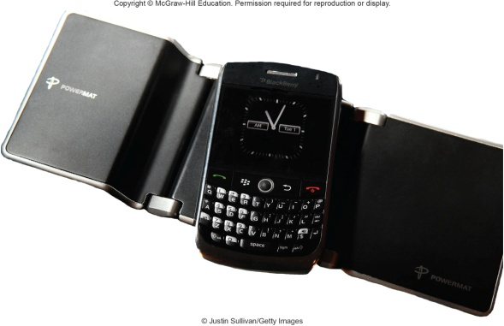
Power Supply
Computers require direct current (DC) power converting alternating current (AC) from wall outlets or batteries
Desktop computers have a power supply unit in the system unit
Laptops use AC adapters in the system unit
Tablets and mobile devices use internal AC adapters
Smartphones can use wireless charging platforms
Notes:
Direct current (DC) powers computers
Desktop computers have a power supply unit (key term) unit located within the system unit
Laptop computers use AC adapters (key term) that are located outside the system unit
Tablets and mobile devices use AC adapters
Smartphones use a wireless charging platforms

Slide 29
Electronic Data and Instructions
Digital electronic signals
Recognized by computers
Analog signals
Continuous signal
Created by voices
Conversion must take place from analog to digital before processing can occur
Notes:
Digital signals (key terms) – electronic signals only recognized by computers
Analog signals (key terms) – created by voice

Slide 30
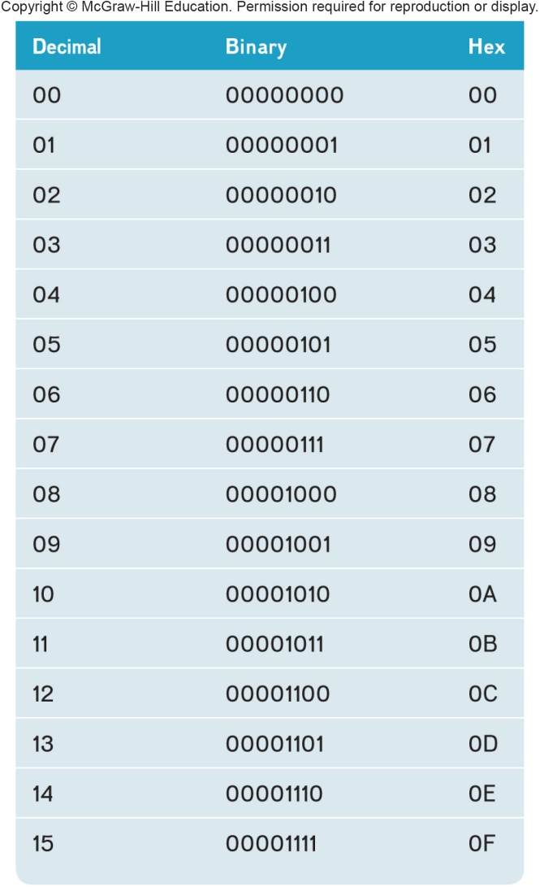
Numeric Representation
Two-state binary system consists of only two digits called bits
On = 1; negative charge
Off = 0; no charge
Byte = 8 bits grouped together
Hexadecimal system
Uses 16 digits to represent binary numbers
(0, 1, 2, 3, 4, 5, 6, 7, 8, 9, A, B, C, D, E, F)
Notes:
Binary System (key term) – consists of only two digits, 0 and 1. Each 0 or 1 is called a bit (key term) which is short for binary digit
8 bits grouped together is a byte (key term)
Binary numbers are difficult to read so they are represented in a hexadecimal system (key term) or hex using 16 digits to represent binary numbers

Slide 31

HARDWARE -Part 3 (Input and Output) Introduction
Have you ever wondered how information gets into your computer or comes out in a form you can use?
Input devices convert what we understand into what the system unit can process
Output devices convert what the system unit has processed into a form that we can understand

Slide 32
Learning Objectives Part 3 – Input and Output
Define input.
Describe keyboard entry including types and features of keyboards.
Identify different pointing devices including game controllers and styluses.
Describe scanning devices including optical scanners, RFID readers and recognition devices.
Recognize image capturing devices and audio-input devices.
Define output.
Identify different monitor features and types including flat-panels and e-books.
Define printing features and types including inkjet and cloud printers.
Recognize different audio and video devices including portable media devices.
Define combination input and output devices including multifunctional devices, telephones, drones, robots, and VR headgear and gloves.
Explain ergonomics and ways to minimize physical damage.

Slide 33
What is Input?
Any data or instructions used by a computer
Input devices translate data into a form that the system unit can process
Some hardware input devices include:
Keyboards
Mice
Pointing
Scanning
Image capturing
Audio-input
Notes:
Input (key term)
Input devices (key term) are hardware used to translate words, sounds, images, and actions that people understand into a form that the computer can understand
Input allows user to put their information into computer language
Most common are keyboard, mouse, scanning devices, image capturing devices and audio-input devices

Slide 34
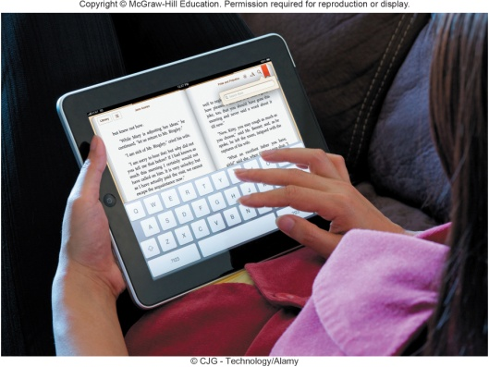
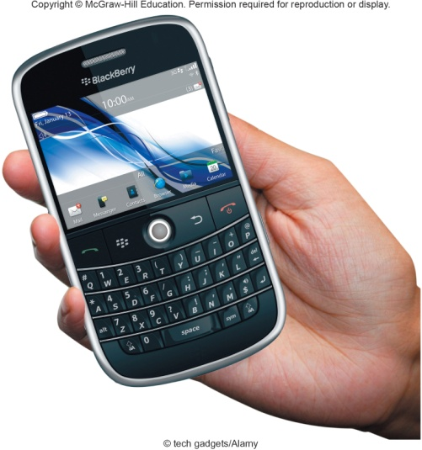
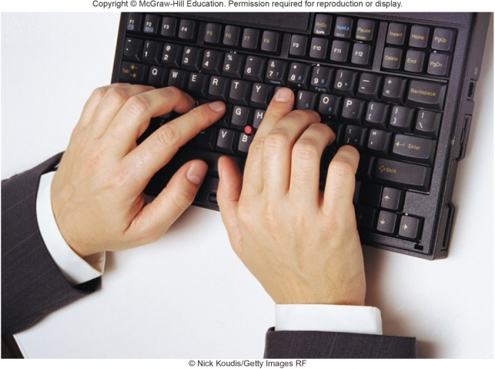
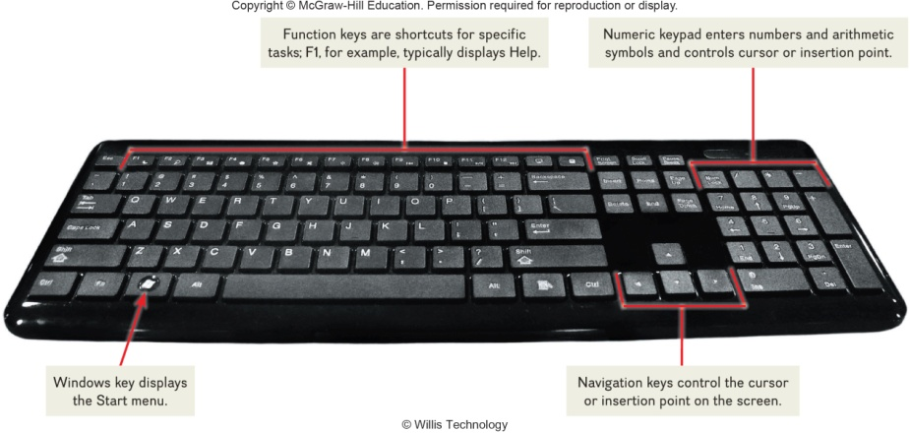
Keyboard Entry
Keyboards
Traditional keyboards
Laptop keyboards
Virtual keyboards
Thumb keyboards
Notes:
Keyboards (key term) come in a variety of designs – most common way to input data
Range from full-sized to miniature and from rigid to flexible
Common types
Traditional keyboard (key term) – full sized, rigid, rectangular keyboards that include function, navigational, and numeric keys
Laptop keyboard (key term) – used on laptop computers
Virtual keyboard (key term) – keyboard for a tablet PC and mobile devices– shown on a touch screen
Thumb keyboard (key term) – used on smartphones

Slide 35
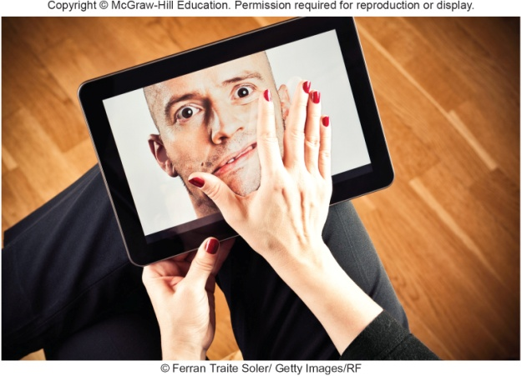
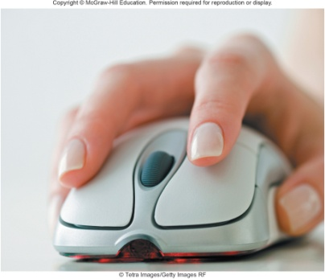
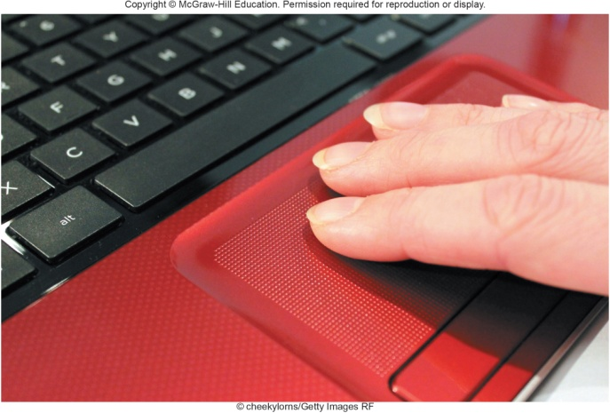
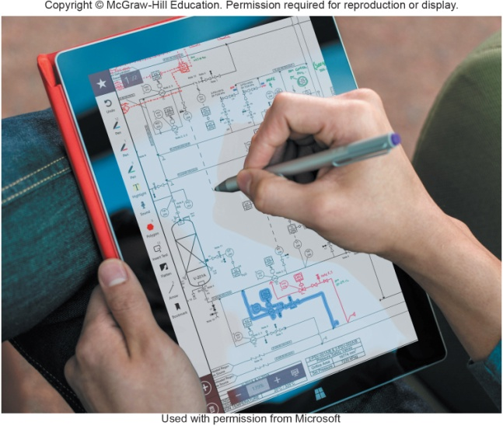
Pointing Devices
Provide an intuitive interface by accepting pointing gestures and converting them into machine-readable input
Wide variety of devices such as Mouse, Touch screen, Game controller, Stylus
Mouse Types
Touch Screen
Optical mouse
Has no moving parts
Emits and senses light to detect mouse movement
Can be used on any surface
Wireless mouse
Battery operated
Uses radio waves or infrared light waves
Touch pads
Controls pointer by moving and tapping your fingers on the surface of the pad
Can be touched with more than one finger
Common on mobile devices
Apple iPhone
Notebook computers
Desktop monitors
Stylus is a pen-like device
Used on tablets
Uses handwriting recognition software
Notes:
Pointing Devices (key term) provide an intuitive interface by accepting pointing gestures and converting them into machine-readable input

Slide 36
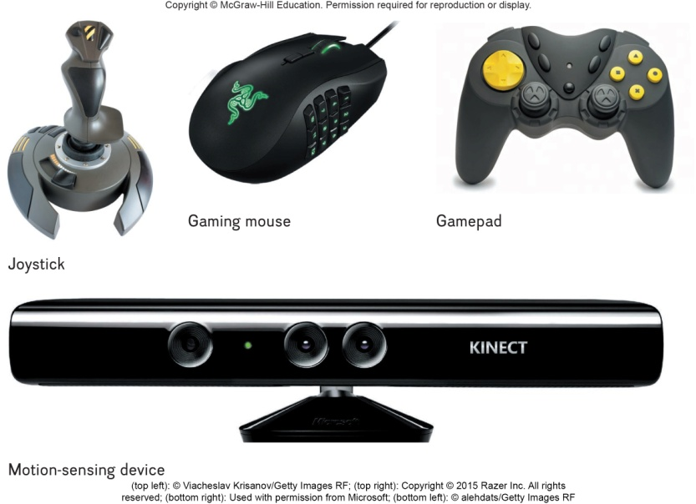
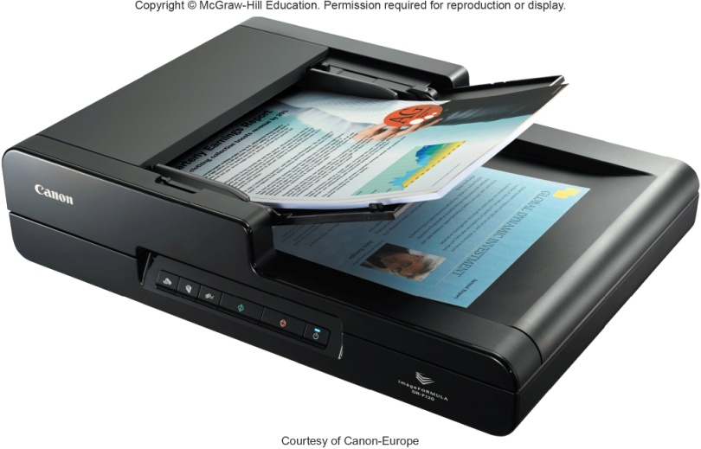
Gaming Controllers
Scanning Devices
Provide input to computer games
Joysticks use pressure and direction of the stick
Gaming mice are similar to a mouse but high precision
Game pads use both hands
Motion sensing device control games by user movement
Scanners convert scanned data into a form the system unit can process
Optical scanners
Flatbed scanners
Document scanners
Portable scanners
3D scanners
Notes:
Joystick (key term)– control game actions by varying pressure, speed and direction
Gaming Mouse – similar to traditional mice with higher precision, faster responsiveness, programmable buttons, and better ergonomics
Game pads (key term) – held by two hands
Motion sensing device (key term) – control games by user movement

Slide 37
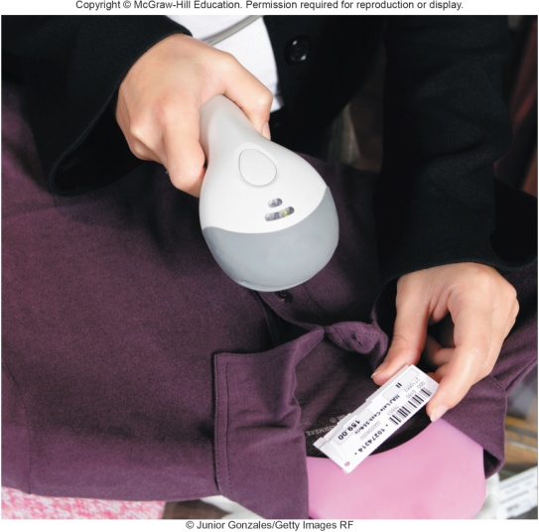
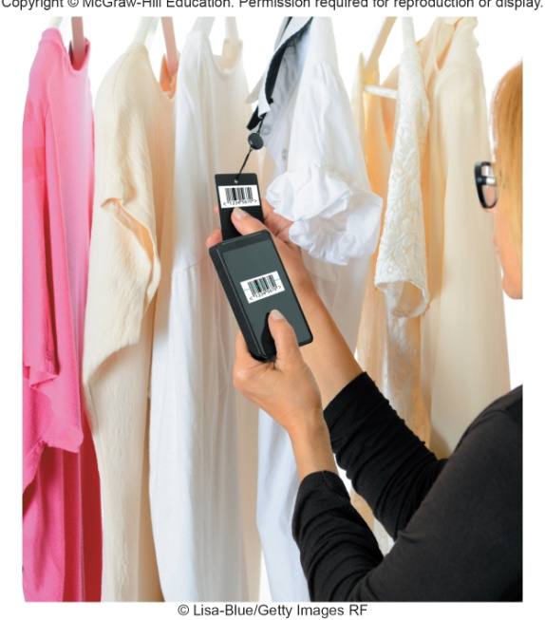
Card Readers
Bar Code Readers
Interpret encoded information that is stored on debit, credit and identification cards
Magnetic card reader
Information read from strip when swiped through reader
Smart cards hold additional security information
Contain photo-electric cells that scan or read bar codes or the zebra striped marks printed on product containers
Wand readers
Hand –held readers
UPCs and MaxiCode readers
UPC are heavily used in grocery stores for automated checkout and inventory control
MaxiCode used by shipping companies for routing packages
Notes:
Card Readers (key term) interpret encoded information that is stored on debit, credit, and identification cards
Types
Magnetic card reader (Key Term) – information is stored on a thin magnetic strip on the back of a card; is read when swiped through a card reader

Slide 38
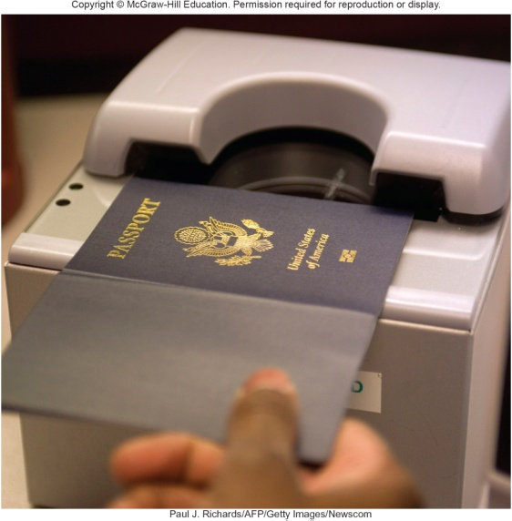
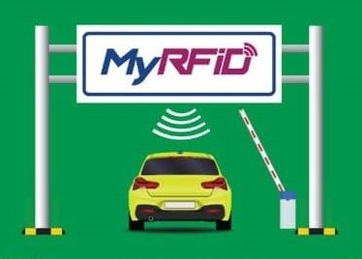
RFID Readers
Character and Mark Recognition Readers
Radio-frequency identification
Tiny chips embedded in most anything contain electronically stored information that can be read using an RFID reader located several yards away.
Tracking pets
Update and control inventories
Read passports
Recognize special characters and marks
Character and mark recognition devices
Magnetic-ink character recognition (MICR)
Used by banks to read encoded characters on checks
Optical-character recognition (OCR)
Reads preprinted characters such as wand scanners
Optical-mark recognition (OMR)
Sense the presence of absence of marks used for test scoring
Notes:
RFID (radio frequency identification) tags are tiny chips embedded for tracking in most anything.
They contain electronically stored information that can be read using an RFID readers
Read by RFID readers (key term)

Slide 39
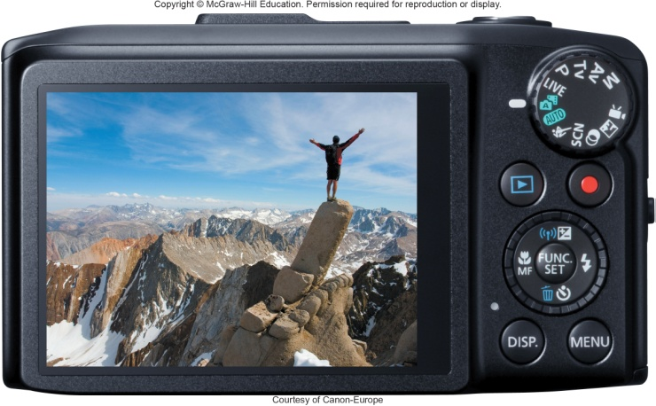
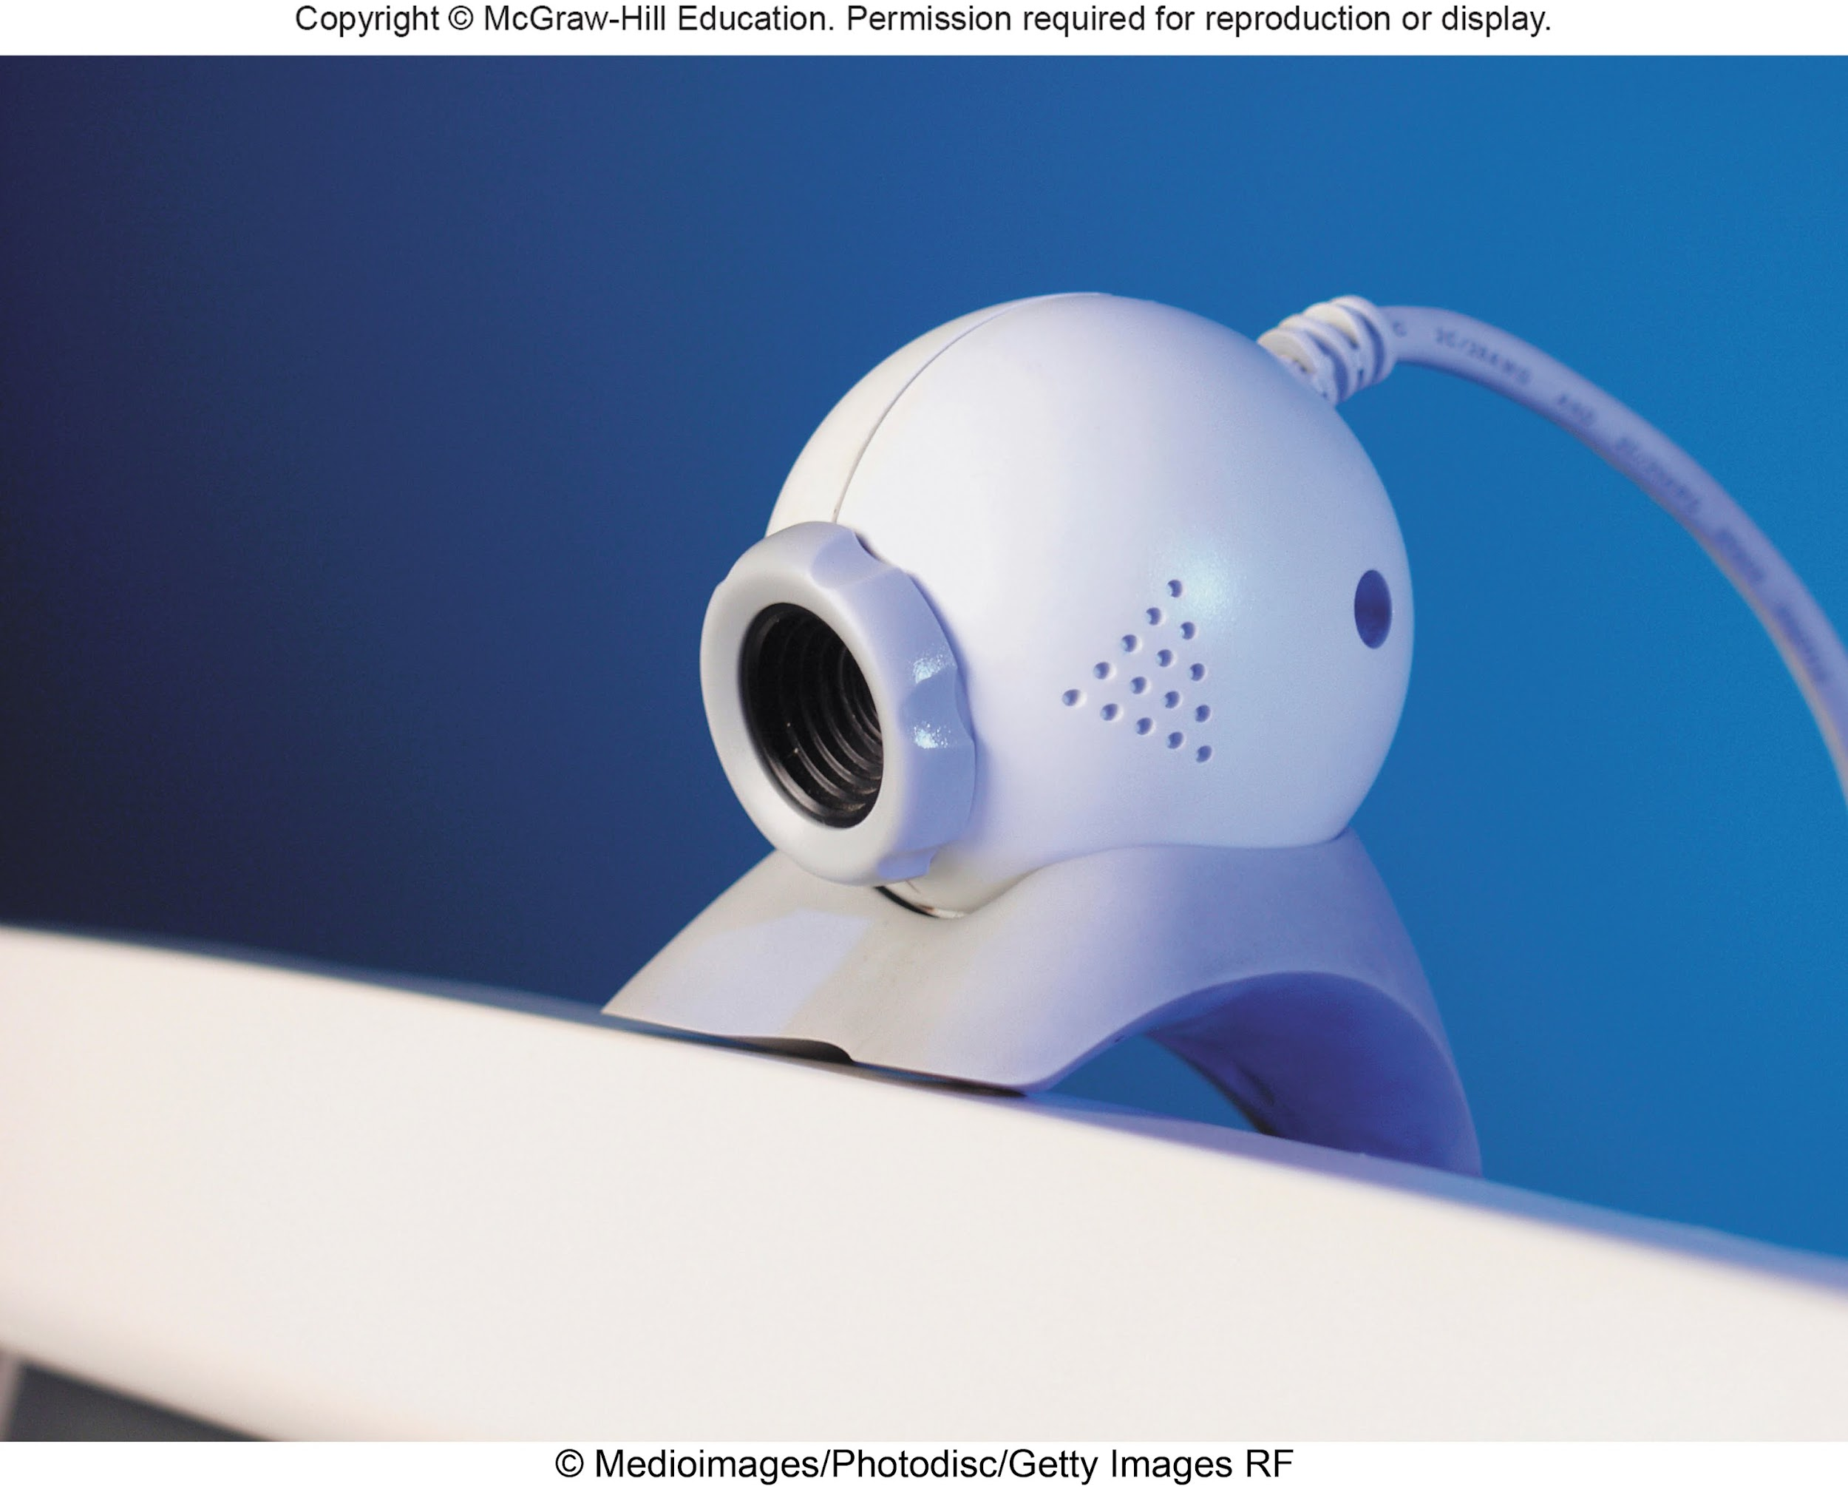
Image Capturing Devices
Audio-Input Devices
Create or capture original images
Digital Camera
Capture images digitally and store in memory
Web Cams
Capture images and send to a computer
Voice recognition systems
Use a microphone, sound card, and special software
Users can operate computers and create documents using voice commands
Included in many smart phones
Siri in iPhones
Cortana in Windows phones
Google Now in Google phones
Notes:
Imaging capturing devices create or capture original images
Digital cameras (key term) – similar to traditional cameras except images are recorded digitally on disk or a camera’s memory
Webcams (key term) – also referred to as web cameras are specialized digital video cameras that capture images and send them to a computer to broadcast over the Internet
Built into smartphones and tablets

Slide 40
Output
Processed data or information
Types of output (Text, Graphics/photos, Audio & video)
Output devices – Monitors, Printers, Audio-output devices
Monitors | Monitor Types | Curved Monitors | E-book Readers | Other Monitor Types
-Known as screens or display screens and present visual images of text and graphics -Output referred to as soft copy -Features: Clarity Resolution/pixels Dot pitch Contrast ratios Size Aspect ratio | Flat-panel monitors: -Require less power to operate -Portable and thin -Most are backlit Three types: 1. Liquid Crystal Display (LCD) - Older monitors 2. Light Emitting Diode (LED) - More advanced backlighting 3. Organic Light Emitting Diode (OLED) - Thin layer organic compound that produces light | Has a concave screen that provides better viewing angles near the edges of the screen Used by high-end gamers Used for smart watch displays | An e-book is a traditional books printed in electronic form E-book readers are dedicated mobile devices for storing and displaying e-books Use e-ink technology -Produce images that reflect light (Kindle, Nook) | Other monitors: i) Digital/interactive whiteboards Connects to a computer or project Controlled using a special pen or even your finger (used in Classrooms and corporate boardrooms) ii) Ultra High-definition television (UHDTV) Digital output delivering a much clearer and more detailed image that regular HDTV iii) Digital Projector - Project the images from a traditional monitor onto a screen or wall
Notes:
Output (key term) is process data or information
Converts machine-readable information into people-readable form
Most common output types – text, graphics, photos, audio, and video
Output device is any hardware used to provide or to create output
The most widely used output devices (key term) are monitors, printer, and audio-output devices

Slide 41
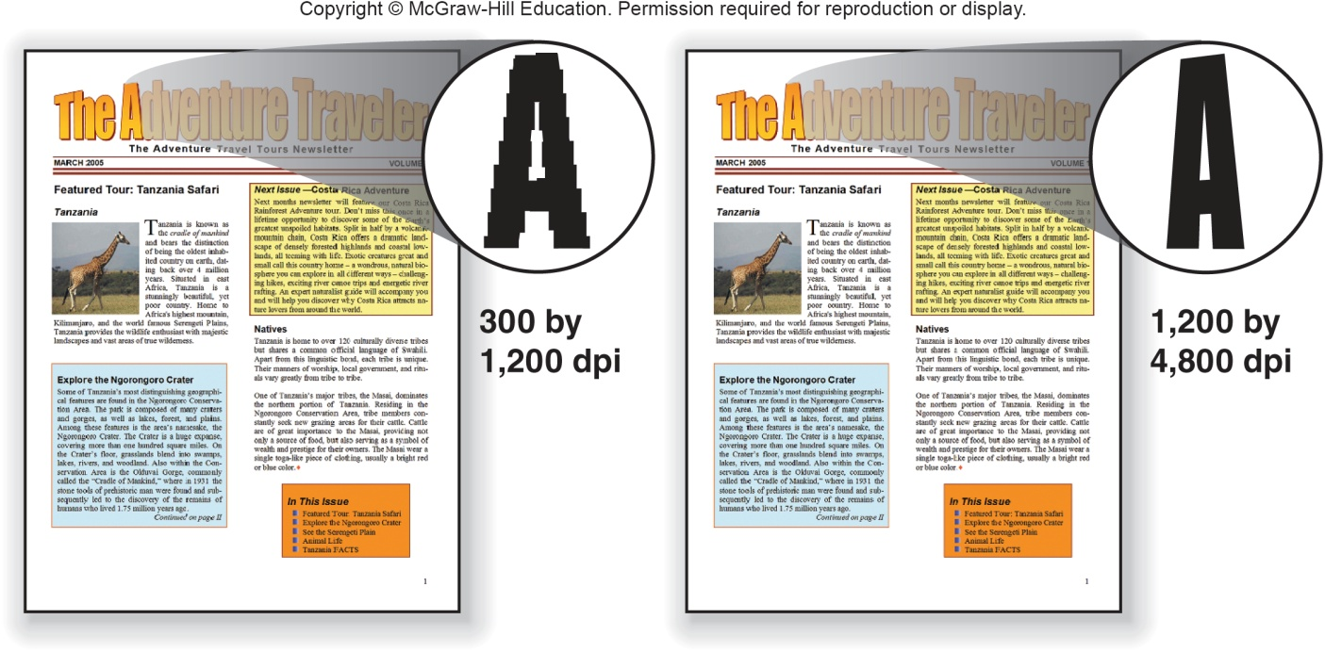
Printers
Translates information that has been processed by the system unit
Output referred to as hard copy
Features
Resolution
Color
Speed
Memory
Duplex printing
Notes:
Printers (key term) translate information that has been processed by the system unit and present the information on paper
Output is called hard copy
Features
Resolution (key term) – measures the clarity of images produced
Measured in dots-per-inch (dpi) (Key Term)
Most printers use an average of 1200 dpi x 4800 dpi; the higher the dpi, the better the quality of image produced
Color (key term) – more expensive to print in color; usually have the option to print in either color or b/w. Grayscale (key term) images are displayed using shades of gray.
Speed (key term) – measured in the number of pages printed per minute
15-19 pages per minute is the average for a single color page (black); 13-15 pages per minute for color
Memory (key term) – used to store printing instructions and documents waiting to be printed
Duplex printing (key term) – automatic printing on both sides of a sheet of paper

Slide 42
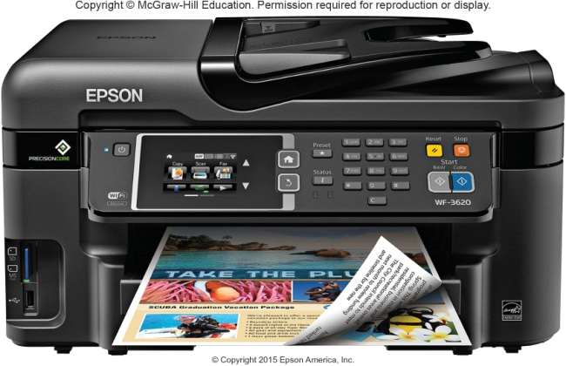
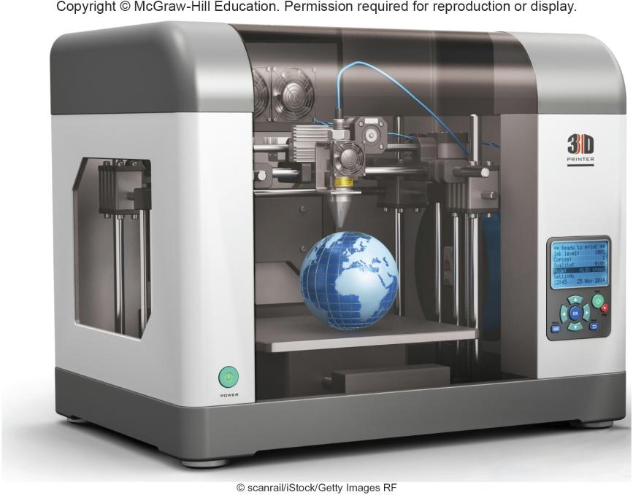
Printer Types
Ink-jet printers spray ink at a high speed
Reliable, quite and inexpensive
Laser printers uses a laser light beam to produce images
Fast, excellent quality
Personal or shared
3D Printers create 3-D shapes with a thin layer of material repeatedly until created
Additive manufacturing
Other Printers
Cloud printers (Connected to the Internet to provide services to others on the Internet
Thermal printers
Plotters
Notes:
Inkjet printers (key term) spray ink at high speed onto the surface of paper
Reliable, quiet and inexpensive
Laser printers (key term) uses a laser light beam to produce images
Faster, excellent quality and more expensive than ink jet printers
Personal (key term) and shared (key term) laser printers
3D Printers (key term)
Creates 3-dimensional shapes, adds a thin layer of material repeatedly until the item is created

Slide 43
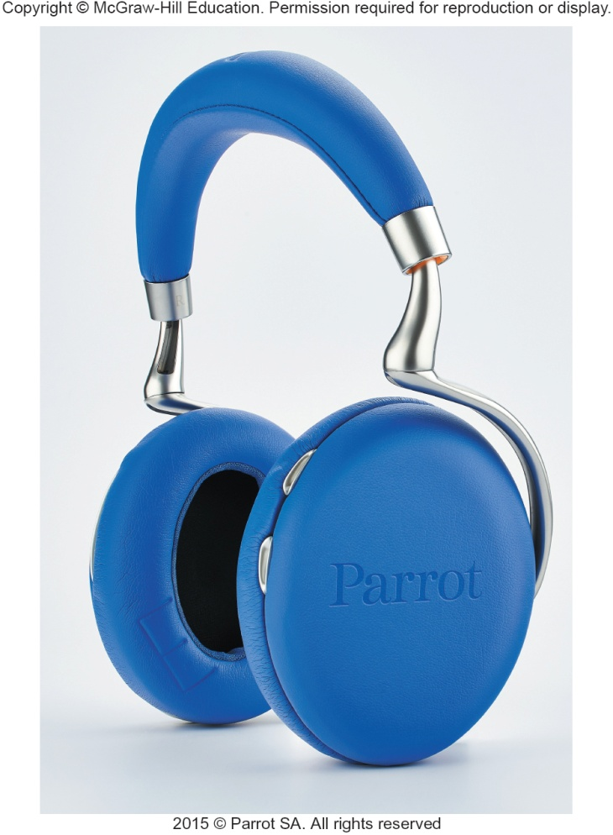
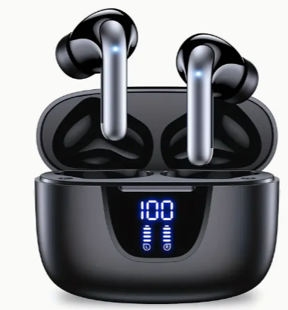
Audio and Video Devices
Translates audio information from the computer into sounds that people can understand
Speakers and headphones
Bluetooth Technology
Wireless technology
Used to connect to speakers and headsets
Notes:
Speakers (key term) and headsets (key term) are the most widely used audio-output devices
Connected to a sound card in the system unit
Voice output is quite common; creating voice output is not as difficult as recognizing and interpreting voice input
Bluetooth (key term) technology – wireless technology used to connect speakers and headsets to wireless sound cards

Slide 44
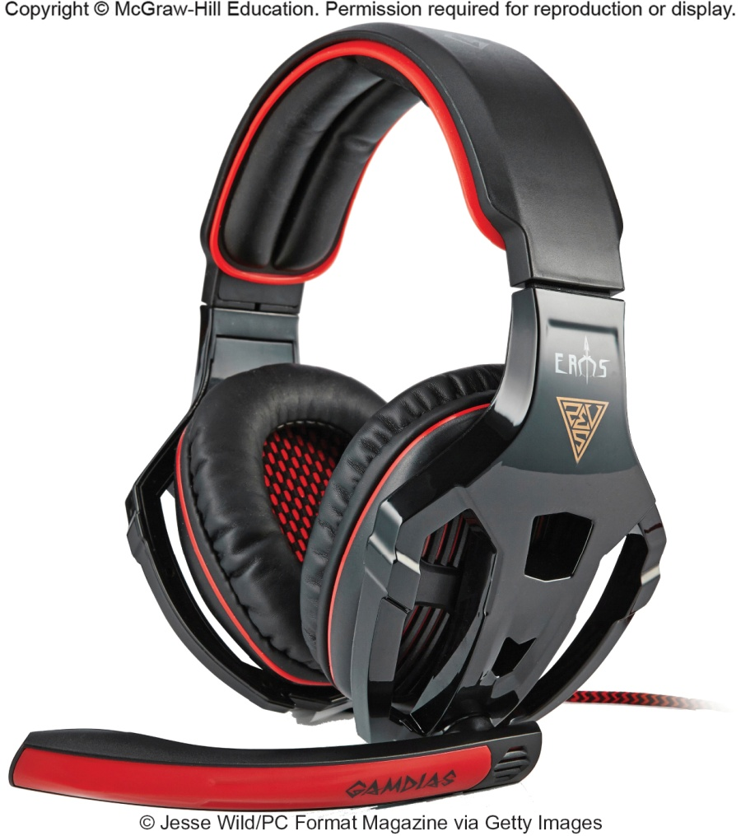
Combination Input and Output Devices
Headsets
Combine a microphone and headphones
Multifunctional devices (MFD)
Cost efficient but lower quality
All-in-one printers are a good example
Telephones
Known as Telephony and Internet Telephony
Voice-over IP (VoIP)
Hangouts
Face Time
Skype
Notes:
Multifunctional devices (MFD) (key term) combine the capabilities of a scanner, printer, fax and copy machine
Usually lower in price and more cost efficient than purchasing the products separately; however the quality is lower
Telephone (key term) – specialized input and output devices for receiving and sending voice communication
Voice over IP (VoIP) (Key Term) – voice and other types of communication over the Internet
Also known as telephony (key term) and Internet telephony (key term) - VoIP application that uses VoIP
Providers include Hangouts, FaceTime, and Skype
Skype – doesn’t need any special hardware. Once you subscribe use your computer’s existing audio and video to communicate with any other Skype subscribers. Skype is free for domestic calls and low-cost for international. For an additional fee you can place calls to non-Skype subscribers.

Slide 45
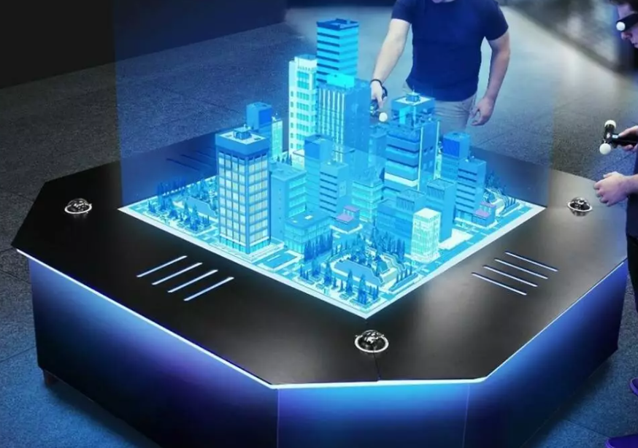


3D visual
Hologram
created using light interference patterns.
3D image that can be seen without a screen or special glasses, appearing to have depth in space and being visible from multiple angles.
Virtual Reality (VR) headsets
- provide a fully immersive 3D experience, E.g –Oculus Quest, HTC vive
Augmented Reality (AR)/ Mix Reality (MR) headsets
overlay 3D virtual objects onto the real world, blending virtual and physical environments. E.g – Magic Leap
Projection Mapping (3D projection System)
Projecting 3D visual onto physical surfaces such as building or objects to create depth and dimension
Notes:
Hologram
https://axiomholographics.com/

Slide 46


Drones and Robots
Drones or unarmed aerial vehicles
Take input from a controller and send back video and sound to the user
Very cost effective now
Robots
Use microphones, cameras and other sensors as input
Output is dependent on the use for the robot
Assists in surgery
Notes:
Drones or unarmed aerial vehicles take input from a controller and send video and sound back to the user.
They are now more cost effective
Robots use microphones, cameras and other sensors as input. The output is dependent on the use for the robot.
Robots even assist in surgery
Virtual Reality (key term) – simulated reality created in 3-d through computers. Creates a virtual or (immersive experience)
Headgear (key term) and gloves (key term) have sensors to collect data that work with software

Slide 47




Making IT Work for You ~ Skype
Communications tool using VoIP
www.skype.com

Slide 48

Ergonomics
Study of human factors related to things people use
Fit the task to the user to avoid:
Eyestrain and headache
Back and neck pain
Repetitive strain injury
Notes:
Ergonomics (key term) – fitting the task to the user
Study to avoid :
Eyestrain (key term) and headache (key term) – 15 minute break every hour
Back and neck pain (key term) – equipment should be adjustable
Repetitive strain injury (key term) RSI (key term) – injury caused by repetitive injury
Carpal tunnel syndrome (Key term) – damage to nerves and tendons in hands

Slide 49
Ergonomic Challenged Devices
Portable devices are not set up for ergonomics
Laptops
Because the keyboard and monitor are connected, they cannot be set up ergonomically
Tablets
Tablet hunch is caused by the users head being improperly aligned to the viewing surface
Smartphones
Blackberry thumb results from using thumbs to type on a tiny keyboard
Notes:
Portable devices are not set up for ergonomics
Study to avoid :
Laptops – raise the level of the screen with books or reams of paper or connect an external keyboard
Tablets – avoid tablet hunch by taking frequent breaks or using a stand or external keyboard
Smartphones – avoid blackberry thumb by keeping wrists straight, head up and shoulders straight.

Slide 50

HARDWARE -Part 4 (Secondary Storage) Introduction
Data storage has expanded from text and numeric files to include digital music files, photographic files, video files, and much more.
These new types of files require secondary storage devices with much greater capacity.
In Part 3 (hardware), you learn about the many types of secondary storage devices including their capabilities and limitations.

Slide 51
Learning Objectives Part 4 – Secondary Storage
Distinguish between primary and secondary storage.
Identify the important characteristics of secondary storage, including media, capacity, storage devices, and access speed.
Describe hard-disk platters, tracks, sectors, cylinders, and head crashes.
Compare internal and external hard drives.
Compare performance enhancements including disk caching, RAID, file compression, and file decompression.
Define optical storage including compact discs, digital versatile discs, and Blu-ray discs.
Define solid-state storage, including solid-state drives, flash memory cards, and USB drives.
Define cloud storage and cloud storage services.
Describe mass storage, mass storage devices, enterprise storage systems, and storage area networks.

Slide 52
Storage
Primary storage is:
Volatile storage
Loses content when the computer loses power
Temporary storage
Random Access Memory (RAM)
Secondary storage is:
Nonvolatile storage
Stores programs and data regardless of power
Permanent storage
Permanently saves information for future use
Notes:
Primary storage (key term) temporary storage
Primary storage is temporary – loses content when computer loses power
Secondary storage (key term) permanently saves information for future use; to share information with others; to modify at later date using secondary storage devices (key term)
Secondary storage is nonvolatile – stores programs and data as opposed to temporary storage (RAM)

Slide 53

Secondary Storage Characteristics
Secondary storage characteristics
Media
Physical materials that holds data and programs
Capacity
How much the media can hold
Storage devices
Hardware that reads data and programs
Access speed
Amount of time required to retrieve data from storage
Writing is the process of saving information to storage
Reading is the process of accessing information from storage
Notes:
Characteristics include:
Media or medium (key term) – actual physical materials that holds the data and programs
Capacity (key term) – measures how much a particular storage medium can hold
Storage devices (key term) – hardware that reads data and programs from storage media (most also write to storage media)
Access speed (key term) – measures the amount of time required by the storage device to retrieve data and programs
Writing– process of saving information to the secondary storage device
Reading – process of accessing information from secondary storage

Slide 54


Hard Disks
Save files by altering the magnetic charges of the disk’s surface to represent 1s and 0s
Use rigid, metallic platters that are stacked one on top of one another
Store and organize files using tracks, sectors, and cylinders
How charges on a disk surface store the letter A
Tracks and Sectors
Notes:
Hard disks (key term) save files by altering the magnetic charges of the disk’s surface to represent 1s and 0s. Density (key term) refers to how tightly these charges can be packed next to one another on the disk
Composed of metallic rather than plastic disks
Platters (key term) – rigid metallic, stacked one on top of another
Track (key term) -rings of concentric circles
Each track is divided into wedge-shaped sections called sectors (key term)
A cylinder (Key Term) runs through each track of a stack of platters
When a hard disk is formatted, tracks, sectors, and cylinders are assigned.

Slide 55

Head Crash
Occurs when read-write head makes contact with the hard disk’s surface or with particles on its surface
Disastrous
Notes:
Read-write head is .000001 inch above surface
Head crash (key term) occurs when read/write head makes contact with surface.
Hard drives are sensitive and something as thin as a human hair can cause a head crash.

Slide 56

Types of Hard Disks
Internal
Located inside the system unit
Used to store programs and data files
You should perform routine maintenance and periodically backup all important files
External
Removable
Used to complement internal hard disk
Notes:
Internal Hard Disk (key term) - Located inside the system unit
Used for storing the operating system, other programs, and large data files
You should perform routine maintenance and periodically backup all important files
External hard drives (key term) are removable and are used to complement an internal hard disk
Use the same technology as internal hard disk
Used to complement internal hard disk.

Slide 57


Performance Enhancements
There are 3 ways to enhance performance.
Notes:
Disk caching (key term)
Uses hardware and software to anticipate data needs; performs function similar to RAM caching; improves processing by acting as a temporary high-speed holding area between a secondary storage device (Key Term) and the CPU
Frequently used data is stored in memory; when needed, the access time is much faster
Redundant arrays of inexpensive disks (RAID) (key term)
Groups of low cost hard-disk drives grouped together using networks and special software
Performs as a single large-capacity disk; but faster than a single disk of comparable size
Often used by Internet servers and large organizations
File compression (key term) and decompression (key term)
Increase storage capacity
Increase speed in file transfers
Reduce space required for storage
WinZip is a well-known program, and you can also use utility programs in Windows.
Supported by both Mac and Windows

Slide 58



Solid-State Storage
Solid–state devices (SSDs) have no moving parts
Solid-state drives
Faster and more durable than hard disks
Access to slash memory or solid state storage
Flash memory cards
Widely used in laptops, smartphones, GPS navigation systems
USB Drives (or Flash Drives)
Connect to USB port
Capacity of 1 GB to 256 GB
Portable
Notes:
Solid state devices have no moving parts
Solid state drives (key term) are faster and more durable than hard drives
Require less power
Contain solid state memory instead of magnetic disk to store data
Used for tablets, smartphones
More expensive and have a lower capacity than hard drives
Flash memory cards (key term) are one type of solid state device.
Used in digital cameras, ipods
USB Drives (key term) or Flash drives (key term) connect to a USB port
Portable

Slide 59


Optical Discs
Hold over 128 gigabytes (GB) of data
Use reflected light to represent data
Lands represent 1s and 0s on the disc
Pits are bumpy areas on the disc that, when light is reflected, determine the 1s and 0s
Use tracks and sectors to organize and store files but only use a single track unlike the hard drive
Optical Disc Types
Optical Disc Formats
Type | Access | Description
CD-ROM | Compact disc – read only mode | Cannot be written to or erased
CD-R | Compact disc – recordable | Can be written to
CD-RW | Compact disc – rewritable | Can be written to and erasable
Notes:
Use laser technology. CD (Key Term) and DVD (Key Term) are optical disc (key term) formats.
Compact, high capacity form of permanent storage (up to 50 gigabytes of data)
Optical discs are read by an optical disc drive (key term)
Laser beam writes by creating a pattern of pits (key term) (holes) and lands (key term) (flat areas) to encode data bits
Laser beams reflect off the pits and lands to read the data
Use tracks and sectors to organize and store files but only use a single track unlike the hard drive

Slide 60

Cloud Storage
The Internet acts as a “cloud” of servers
Applications provided as a service rather than a product
Supplied by servers that provide cloud storage or online storage
Notes:
Cloud computing (key term) is where the Internet provides a cloud of servers that supply applications to clients as a service.
The processing power of the service provider’s server is used to run the applications and your computer is responsible only for displaying the results.
The applications and data can be accessed from any Internet-ready device. This means that devices with little storage, memory, or processing power, such as mobile phones, can run the same powerful applications as a desktop computer.
Cloud servers provide storage, processing, and memory.
Software installation and upgrades are avoided.

Slide 61

Cloud Storage Services
Benefits / Advantages
Maintenance
Hardware upgrades
File sharing and collaboration
Cloud Storage Service Companies
Disadvantages
Access speed
File Security
Notes:
Because the service provider’s server is used to run the application and store the files, even devices with little storage, memory or processing power such as a smartphone can run the same applications as a desktop computer.
Benefits that are handled by the cloud service
Maintenance – disk defragmentation, backups, encryption and security
Hardware upgrades
File sharing and collaboration – users can share and collaborate with anywhere with an Internet connection
Disadvantages
Access speed – transfer rate is dependent upon your Internet connection
File Security – may not be as effective as your personal file security

Slide 62



Making IT Work for You ~ Cloud Storage
Using a cloud storage service makes it easy to upload and share files with anyone.
Starting Dropbox Dropbox Sharing Dropbox
Step 1 Step 2

Slide 63

Mass Storage Devices
To meet the needs of organizations requiring large amounts of secondary storage requirements
Enterprise storage system
Safe use of data across an organizational network
Devices include:
File servers
Networked attached storage (NAS)
RAID systems
Organizational cloud storage
Notes:
Mass storage devices (key term) are designed to meet the demands for a tremendous amount of mass storage (key term).

Slide 64
Storage Area Network (SAN)
Architecture to link remote computer storage devices
Enterprise storage systems can be connected to
Computers to provide local system access
User’s computer provides file system, but SAN provides disk space
House data in remote locations and still allow efficient and secure access
Notes:
Storage area network (SAN) (key term) – a recent mass storage development.

Slide 65
HARDWARE TRENDS –Part 5
Current Trend in Computer Hardware
AI and Machine Learning Hardware
Hardware designed for AI/ ML workload such as GPUs and TPUs, AI chips, NVIDIA Jetson
Optimized for parallel processing, large dataset, high computational
Edge computing and IoT devices
Localized processing to reduce latency in IoT applications.
Critical for real-time application such as autonomous vehicles, smart cities
Growing demand for energy-efficient and low-latency hardware
Edge server, IoT Sensor, IoT gateways, embedded system
Multicore Processor
allow computers to handle multiple tasks simultaneously, improving parallel processing and overall performance
Critical component in smartphones, PCs, servers, and edge devices
E.g ARM processor (Apple M1/M2 chips), RISC-V

Slide 66
HARDWARE TRENDS –Part 5
4. Non-Volatile Memory express (NVMe) storage
NVMe SSDs are replacing older storage technologies due to their speed.
Faster data access and lower latency compared to traditional SATA SSDs.
Critical for data-intensive applications such as gaming, AI, and video editing
5. 5G integration and networking hardware
5G networks drive demand for faster and more reliable data transfer.I
innovations in routers, switches, and modems for 5G applications.
Enables real-time applications like AR, smart cities, and IoT.

Slide 67
HARDWARE TRENDS –Part 5
Future Trend in Computer Hardware
Quantum Computing
leverages the principles of quantum mechanics—the fundamental theory in physics that describes the behavior of particles at the smallest scales (atoms and subatomic particles).
use quantum bits or qubits to process information, which can represent both 0 and 1 simultaneously due to the quantum property called superposition
revolutionize fields like AI, cryptography, optimization and complex simulations
Device and Nanotechnology
Nanotechnology is the aptitude to perceive, measure, operate, and build materials at the nanometer scale, the size of atoms and molecules.
enables the creation of smaller transistors and components, allowing for increased transistor density on integrated circuits
enabling the development of smaller, faster, and more efficient components

Slide 68
HARDWARE TRENDS –Part 5
3. Photonics and Optical computer
uses light (photons) instead of electrical signals (electrons) to perform computations. This allows for higher data transfer rates and less heat generation.
4. 3D chips stacking and heterogeneous computing
stacking chips vertically to increase performance and reduce power consumption
combining different types of processors (CPU, GPU, FPGA) on a single chip to optimize for specific tasks.
5. Neuromorphic computing
Hardware that mimics the human brain, potentially leading to more advanced AI and cognitive computing
Neuromorphic chips from Intel and IBM are already in development

Slide 69
HARDWARE TRENDS –Part 5
6. Emerging memories technology
Aim to address the limitation of traditional memory type like DRAM and NAND flash storage
Improve in speed, density, energy efficiency, durability
ReRAM (resistive), MRAM (Magnetoresistive), PRAM (Phase change), FeRAM (Ferroelectric), universal memory

Slide 70

Performance of emerging memories

